Slide 1
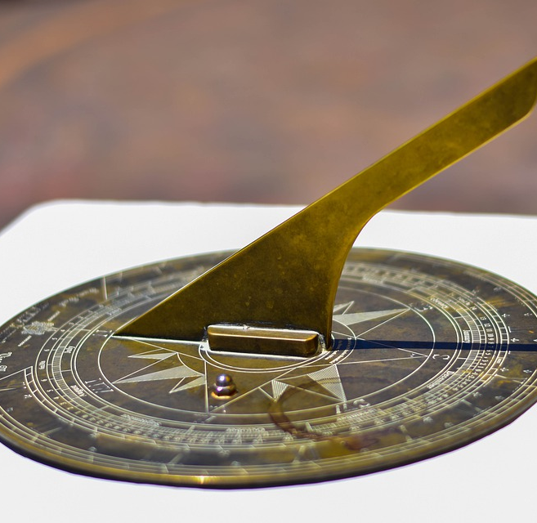
Project Sundial
A 3D Interface for Energy Meter Data
Built on Circaevum

Slide 2
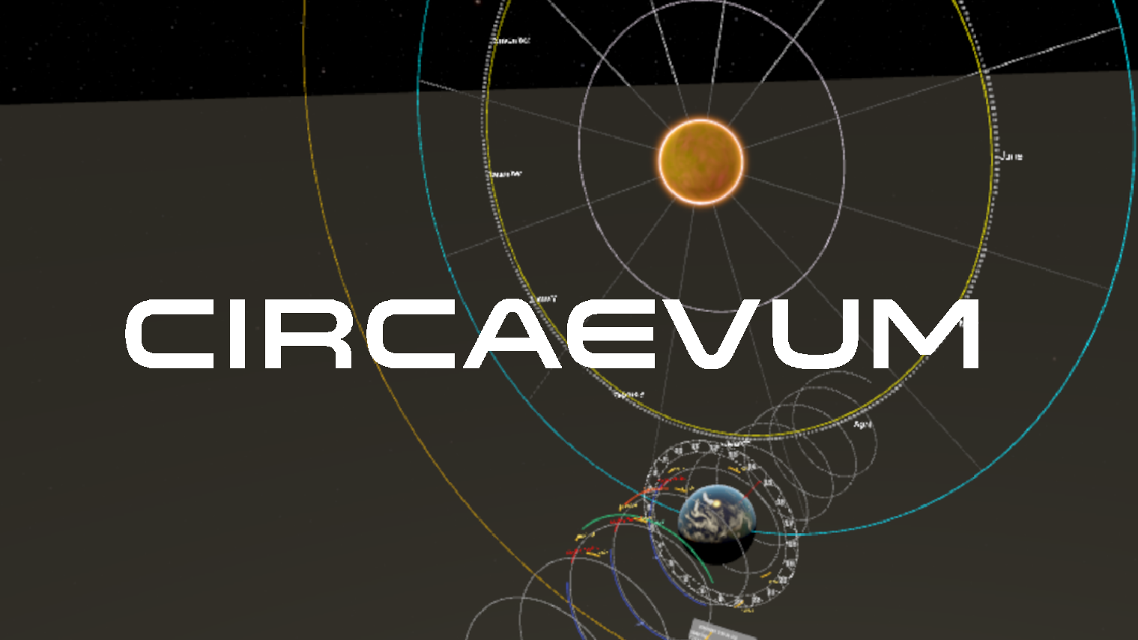
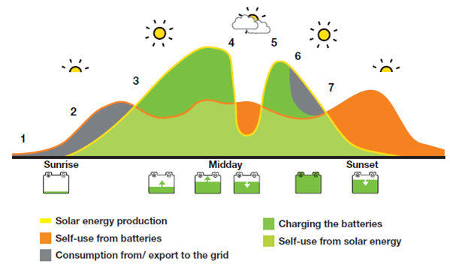
Outline
1. Background 2. Energy Meter Data 3.
+
=

